Slide 1
Arduino Hardware
Presentation
By
Dr. Kesavan Gopal

Slide 2
Outline
Arduino Basics
Arduino - When....
What is AVR?
Arduino Variants/Flavors
What is Arduino Add-ons (Shields)
How does Arduino shields look like?
Arduino UNO - Board
On board Features – Arduino UNO
Specific Pin Details of Arduino UNO
AVR Architecture
ATmega328 – Features Overview
Pin Details of ATmega328
Pin Map b/w ATmega328 & Arduino Uno

Slide 3
Arduino Basics
What is Arduino?
It's an open source electronics prototyping platform:
Open source: resources that can be used, redistributed or rewritten free of charge, often software or hardware.
Electronics: technology which makes use of the controlled motion of electrons through different media.
Prototyping: an original form that can serve as a basis or standard for other things.
Platform: hardware architecture with software framework on which other software can run.

Slide 4
Cont…
Arduino consists of both a physical programmable circuit board (often referred to as a microcontroller) and a piece of software, or IDE (Integrated Development Environment) that runs on your computer, used to write and upload computer code to the physical board.

Slide 5
Arduino - When Where,Who & What?
In 2005 by Massimo Banzi & David Cuartielles
“Strong Friend” Created in Ivrea, Italy
Open Source Hardware (Using Atmel Processor)
Software: Coding is accessible & transferrable → (C++, Processing, java)
Purpose: Creating the electronics fast, rapid Prototyping the concept, Time and cost efficient, serves hobbyists.

Slide 6
What is AVR?
RISC Architecture – Reduced Instruction Set Computer Architecture
AVR Developed - 1996 – Atmel Corporation - Structural Design by Alf-Egil Bogen and Vegard Wollan RISC also known as AVR - Advanced Virtual RISC.

Slide 7
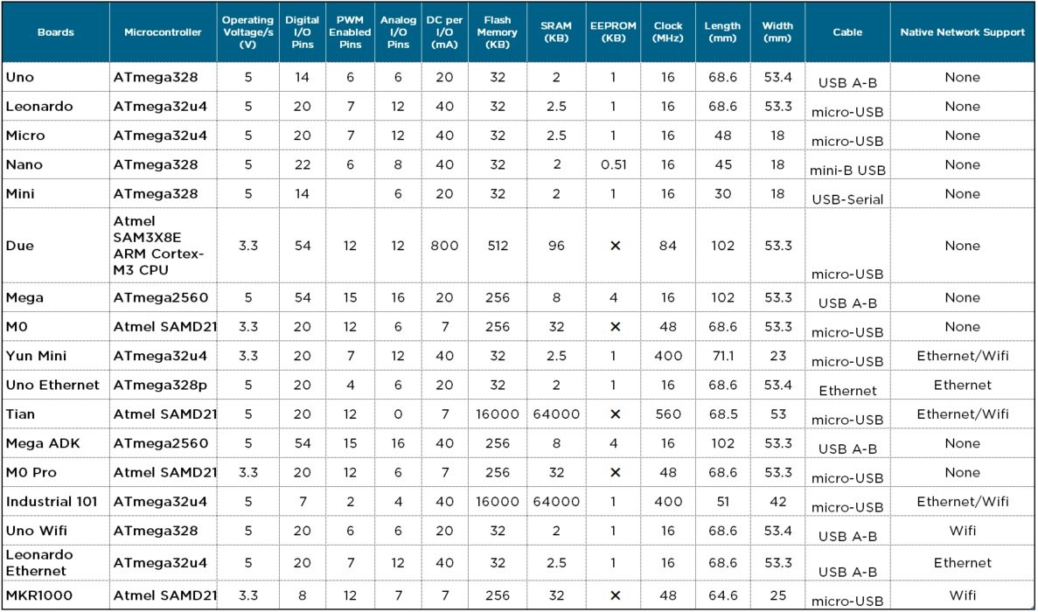
Arduino Variants/Flavors

Slide 8
What is Arduino Add-ons (Shields)
TFT Touch Screen
Data logger
Motor/Servo shield
Ethernet shield
Audio wave shield
Cellular/GSM shield
WiFi shield
Proto-shield
• ...many more

Slide 9
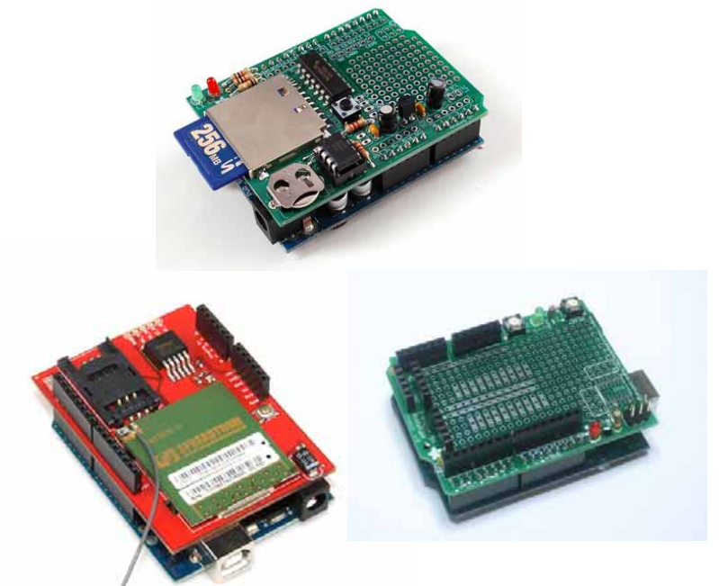
How does Arduino shields look like?

Slide 10
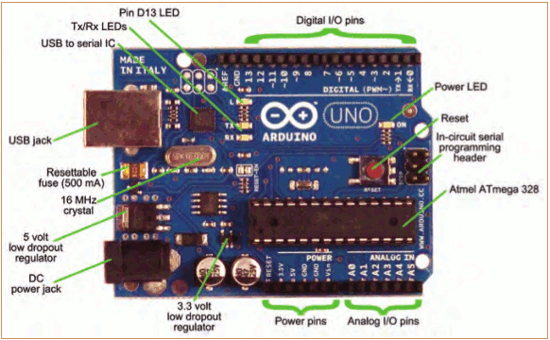
Arduino UNO - Board

Slide 11
On board Features – Arduino UNO
Processor:
Atmega328 (Flash Memory- 32 KB, SRAM- 2 KB, EEPROM 1 KB )
8 MHz Clock Speed (16 MHz – External Crystal in Board)
Display:
Pin D13 – LED
USB Tx/Rx - LED
Power Indicator LED
I/O Pins:
14 - Digital I/O Pins (40 mA support & 6 – PWM)
6 Analog Input pins - A0 – A5
6 Power Pins

Slide 12
Cont…
Interface: USB Type B
Power:
Operating Voltage: 5V
30 mA @3.3V
Supply Voltage Recommended 6 – 12 V & 20 V (Worst),
Other:
SCL – I2C Serial Clock
SDA – I2C Serial Data
Analog Reference voltage

Slide 13
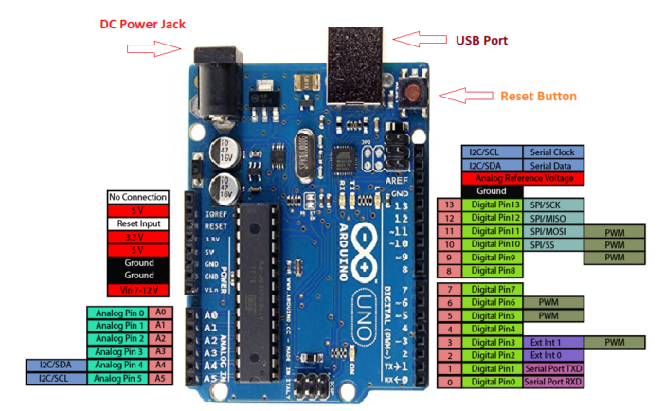
Specific Pin Details of Arduino UNO

Slide 14
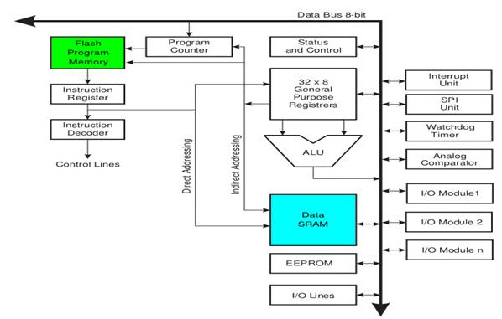
AVR Architecture

Slide 15
ATmega328 – Features Overview
Two 8-bit Timer/Counters Compare Mode
One 16-bit Timer/Counter with Separate Prescaler, Compare Mode, and Capture Mode
Real Time Counter with Separate Oscillator
Six PWM Channels
8-channel 10-bit ADC
Two Master/Slave SPI Serial Interface
One Programmable Serial USART
2-wire Serial Interface (Philips I2C compatible)
Programmable Watchdog Timer
One On-chip Analog Comparator
Interrupt

Slide 16
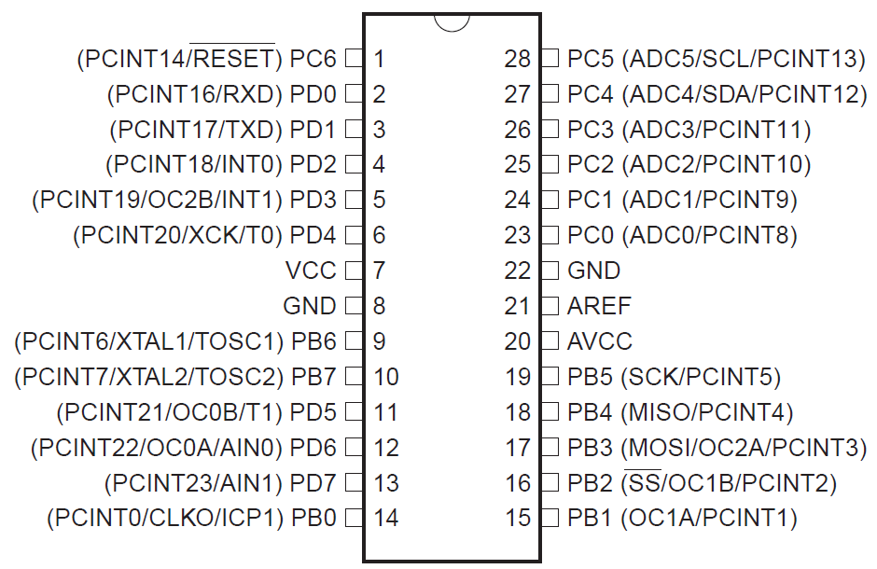
Pin Details of ATmega328

Slide 17
Pins ATmega328
Port B – PB7 – PB0 (8)
Port C – PC6 – PC0 (7)
Port D – PD7 – PD0 (8)
VCC & GND (2)
AVCC & GND (2)
Avref (1)

Slide 18
Next
Arduino IDE installation
Application Development (as per syllabus)
Protocols understanding.

Slide 19
Queries ?

